Slide 1
PREVENTING VIOLENCE IN SCHOOL
AND CRIME IN AFRICA

Slide 2


Slide 3
PREVENTING SCHOOL VIOLENCE
AND CRIME IN AFRICA
FULFILLING SDG GOAL 4
THE SOLUTION
For African Nations Across The World
Dedicated To the Memory OF Those Who Were Shown No Way Of Escape From The Deadly Vices Until They faded Away
NATIOAL SCHOOL CRIME PREVENTION CORPS
( Rgst’d As SCHOOL CRIME PREVENTION ORGANIZATION CAC/IT/NO 90396)
Dr. FOLAYINKA IGE,
Cmmdn’t NSCPC, NIGERA.

Slide 4
CRIME IN AFRICA
The Extension Of Community Violent Clashes By Teenagers & Youths increases crime in Africa.

Slide 5
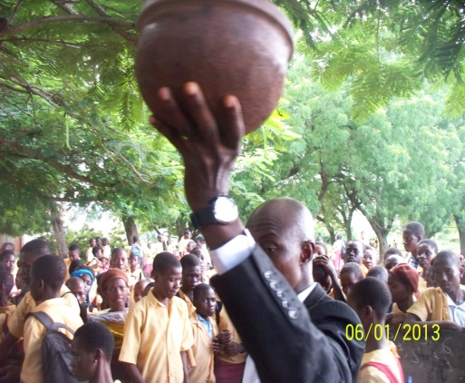


OUR GUIDING AIMS
REFOCUSING THE STUDENTS TO EMBRACE PEACE AT ALL TIME.
PRACTICAL GOAL SETTING
DEVELOPMENT OF STUDENT CREATIVITY
ABILITY TO IMPLEMENT CREATIVE PROBLEM SOLVING STRATEGIES.
ABILITY TO CREATE THE (END) IN MIND
DEVELOPING CONFLICTS RESOLUTION STRATEGIES
BRINGING OUT THE TALENT FROM THE VULNERABLE AFTER REHABILITATION.

Slide 6

OUR GUIDING GOALS
TO CHECK MATE THE CREATION OF MONSTERS TO THE SOCIETY
TO RESTORE LOST GLORY AND INTEGRITY BACK TO SCHOOLS.
TO MAKE EVERY STUDENT A GOOD AMBASSADOR TO HIS /HER IMMEDIATE SOCIETY .
TO STOP VIOLENT STUDENTS I.E CULTIST AND GANGSTERS FROM UNLEASHING MAYHEM ON THEMSELVES.
TO DISCOURAGE YOUTHS/STUDENTS FROM BEING USED AS A WEAPON OF MASS DESTRUCTION.

Slide 7


Slide 8
INTRODUCTION
We are set of organ working to prevent crime in Schools from Primary School to Higher Institutions of learning with remarkable impact.
Till date, we have painstakingly increased the level of crime prevention in Institutions for higher productivity in strategic exposition of dangers in social vices, rehabilitation of deviant students, and reintegration of student Out of Parental Control to their families, as we engage professional input for safer school
environment.
I am Folayinka Ige, pioneer of National School Crime Prevention Corp (NSCPC) registered legally as SCHOOL CRIME PREVENTION ORGANIZATION here in Nigeria which serves as one among many in the mild application of VISUAL METAPHOR DISPLAY for rehabilitating young school children, adults child, propagating peace and safety awareness in the society.
We have been to over 500 schools, including tertiary institutions across Nigeria, teaching over 300,000 students on peace and violence prevention strategies with rehabilitation .

Slide 9
program for over 1500 students, averting destruction of lives , stopping burning down of schools , conducting violence prevention and school safety guides program titled (EXPERT MEETING STOPPING VIOLENCE IN SCHOOLS ROLE OF STAKEHOLDERS) to more than a thousand Head Teachers in Primary School here in and inducting numerous Principals as School Crime Prevention Managers.
As part of SDGs goal, 4 in particular we are committed to the course of quality education, children's behaviour, and societal values re-engineering specifically prevention of school/ youth-in-community crime etc. As the proper monitoring of children live is the safety of the future!

Slide 10
We will be much willing to partner and enumerate further in this peace-building assignment to African Nations.
The use of VISUAL METAPHOR DISPLAY has been highly applauded in more than 500 Schools as a unique tools of School Crime Prevention and PEACE BUILDING methodologies which can also be applicable in other Africa Countries across the World.
We have volunteers who are willing and ready to jointly work in the area of school peace building and violence prevention team if we can be mentored by International Partners.
Our daily access of meeting with them is a great opportunity to change the course of humanity with the little we have.
Thank you very much for the privilege to talk with you, attached some photos of recent / on going activities, your additional methods can also be of greater help here, learning from great people who were frontiers in international forum of crime prevention.
All the best,

Slide 11
In respect of Ministry of Education's school protocol we have letters of authority of partnership with 5 States across the Country , given us free access to enter into all schools as agreed to lecture, organize assembly admonition, counselling and bringing up parent / teacher seminars .( This is not sometimes easy to access for local NGO)
Major constraints lie in the technical facilities to give the program a continuous follow up for wide spread results to reduce interwoven of joint organized crime been facilitated by movement from rural area to urban and vice versa.
Please note, with a right local effort laced with substantial platform it can prevent crime in the school society and the immediate community as they know with good evidences where the shoe pinches/ dark spots and the judicious application of VISUAL METAPHOR DISPLAY as a creative tools amounting to 164 in number can significantly contribute to LOCALLY LED PEACE-BUILDING WORKING GROUP.

Slide 12
PART ACHIEVEMENT SO FAR.
Workshop on SCHOOL CRIME PREVENTTION in over 400 Schools –
Primary, Secondary, Tertiary with recommendation from school administrators.
Able to avert over 120 deadly cult activities across schools.
Rehabilitation/Correctional exercise for over 1500 deviant students who were engaging in social vices- cultism, ‘jagbon’, truancy, raping, extortion, street fight and real time robbery- recorded with factual names, dates and school identity.
EXTENSIVE REHABILITATION /REINTEGRATION PROGRAM FOR ;
A J.S.S 2 student who was selling India hemp and an addicted serial rapist – He was also a threat to students in senior class ( a.k.a small killer)
A drug peddler in J.S.S3
A Secondary School Student in possession of weapons
6 Students who were involved in real occult practices- inflicting a wound on a teacher whom they acclaimed she offended them.

Slide 13
Student who distributes axes in school.
Student who slashed open a fellow student neck with a blade.
A student named Boko Haram who threaten pupils in school
Student in gambling game.
Disruption of a gambling base, which accommodates student for a whole school session..
Discovery of an uncle having carnal knowledge of a 9 year old girl in one of the best Private School and handling over the culprit to police for further enquiry.
The Rehabilitation and Reintegration of a secondary school boy who poisoned his mother- the incident was referred to us from the office of NSCDC.
The rehabilitation of a Principal’s son, who used axe to eject his mother from home and placed a notice of ‘HOUSE FOR SALE’ on the house after selling off house hold properties in the house.

Slide 14
The rehabilitation of 12 boys who intended to burn down their school with PMS.
Rehabilitation and Reintegration of students who fought with their Teachers.
Rehabilitation and Reintegration of students who stoned their Principal.
Rehabilitation and Reintegration of boys who planned to murder their teacher.
etc.

Slide 15

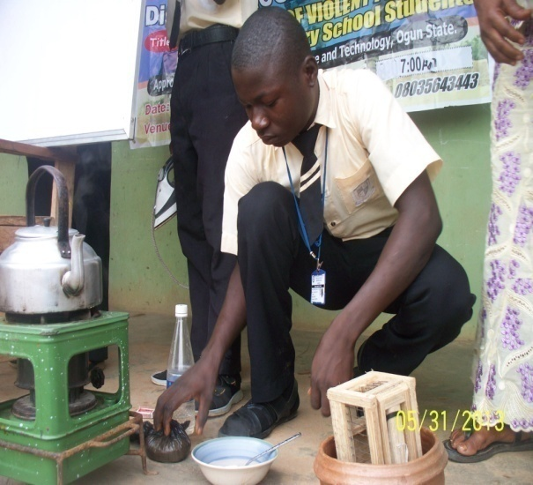
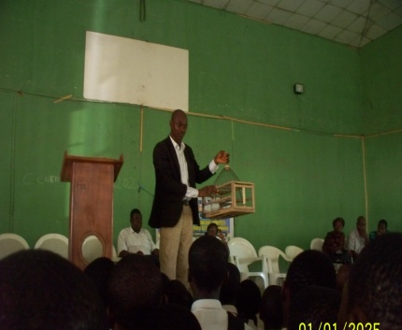
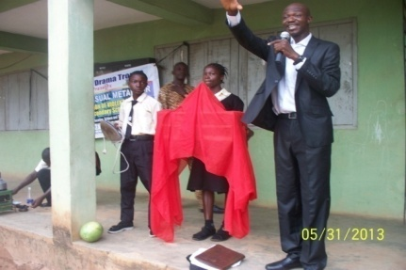
COMMON TOOLS TO STOP VIOLENCE IN SCHOOLS- VISUAL METAPHOR DISPLAY
VISUAL METAPHOR DISPLAY TOOLS
VISUAL METAPHOR DISPLAY TOOLS

Slide 16
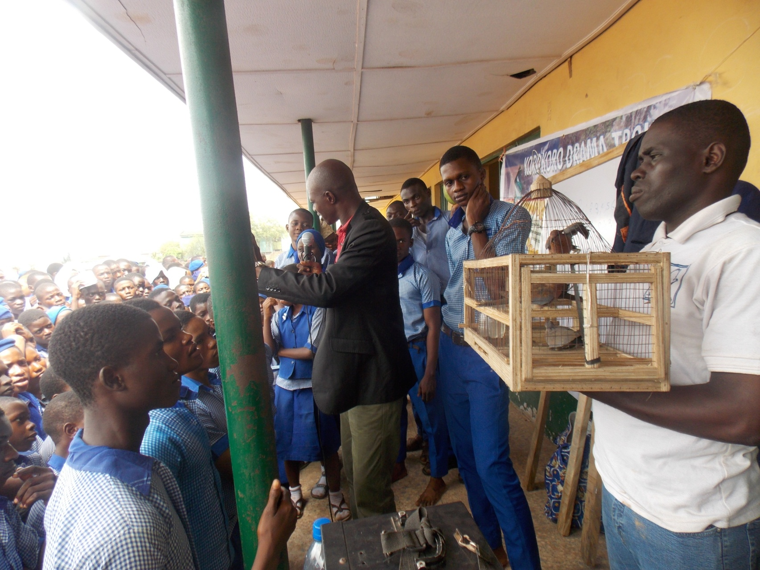
PHOTO SPEAKS – THE RUNNING TOOLS

Slide 17
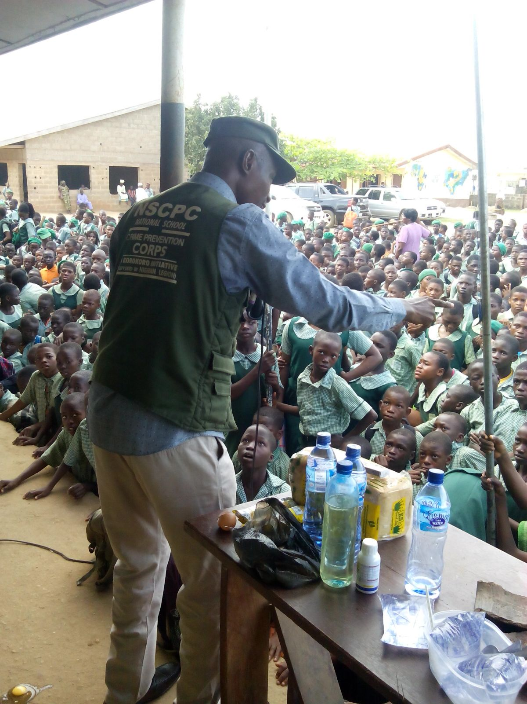
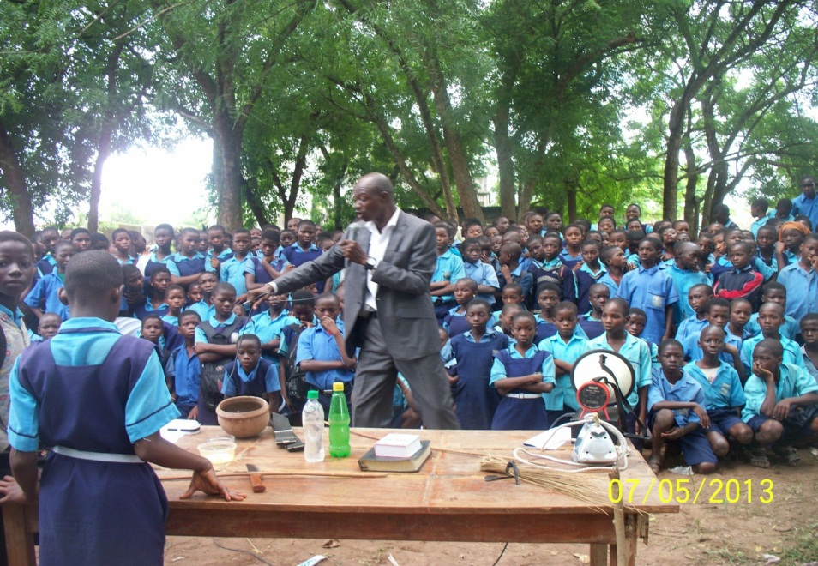
VMD IN FOCUS
THE TOOLS

Slide 18

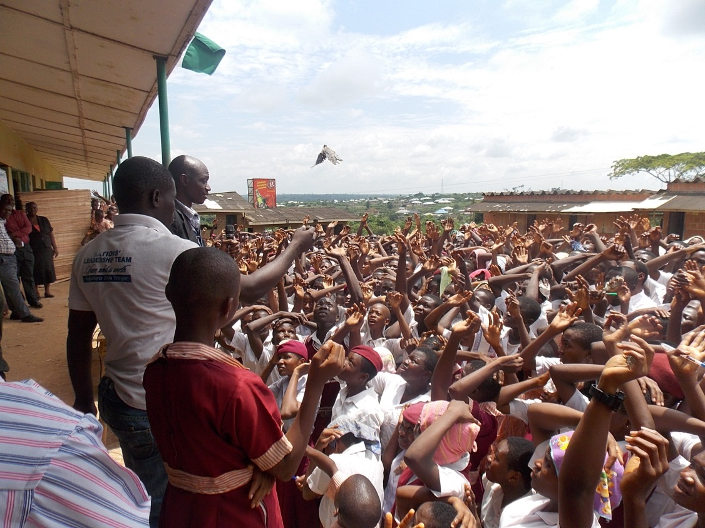
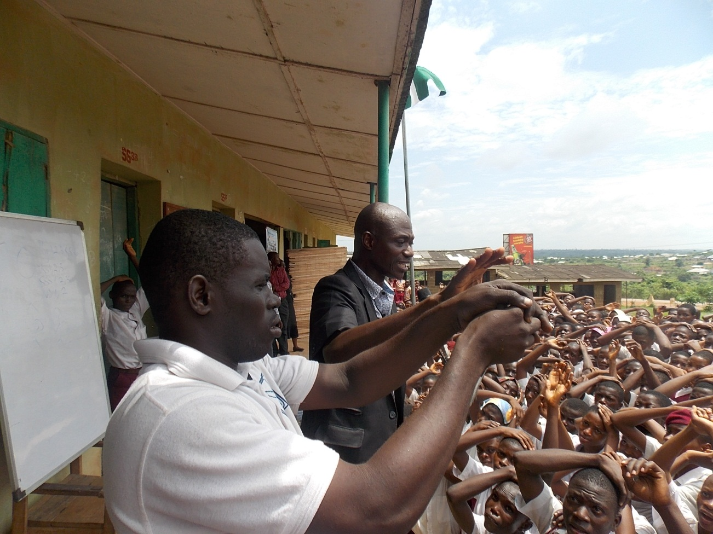
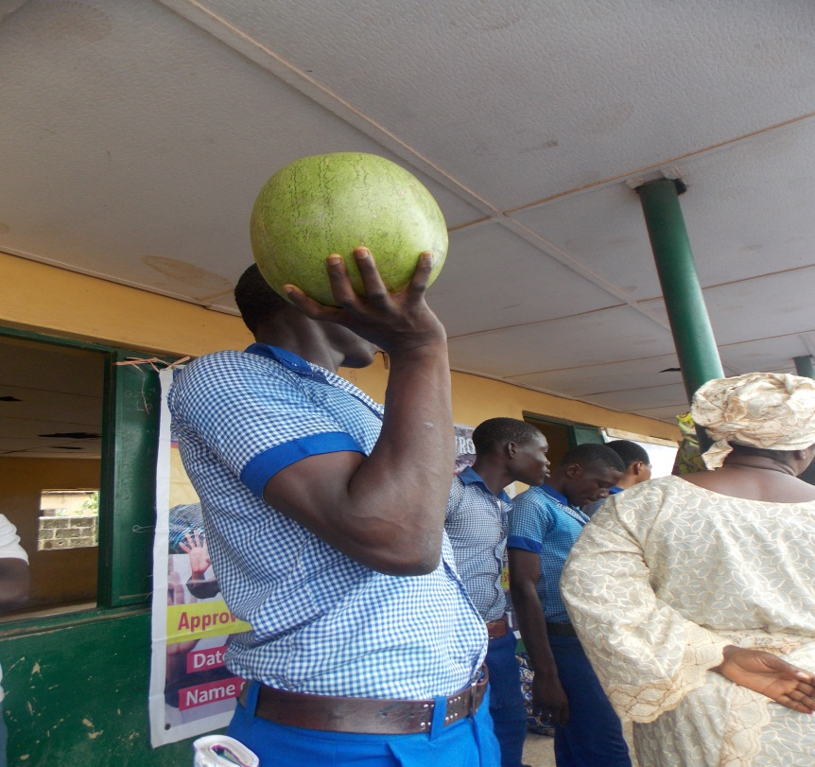

Slide 19
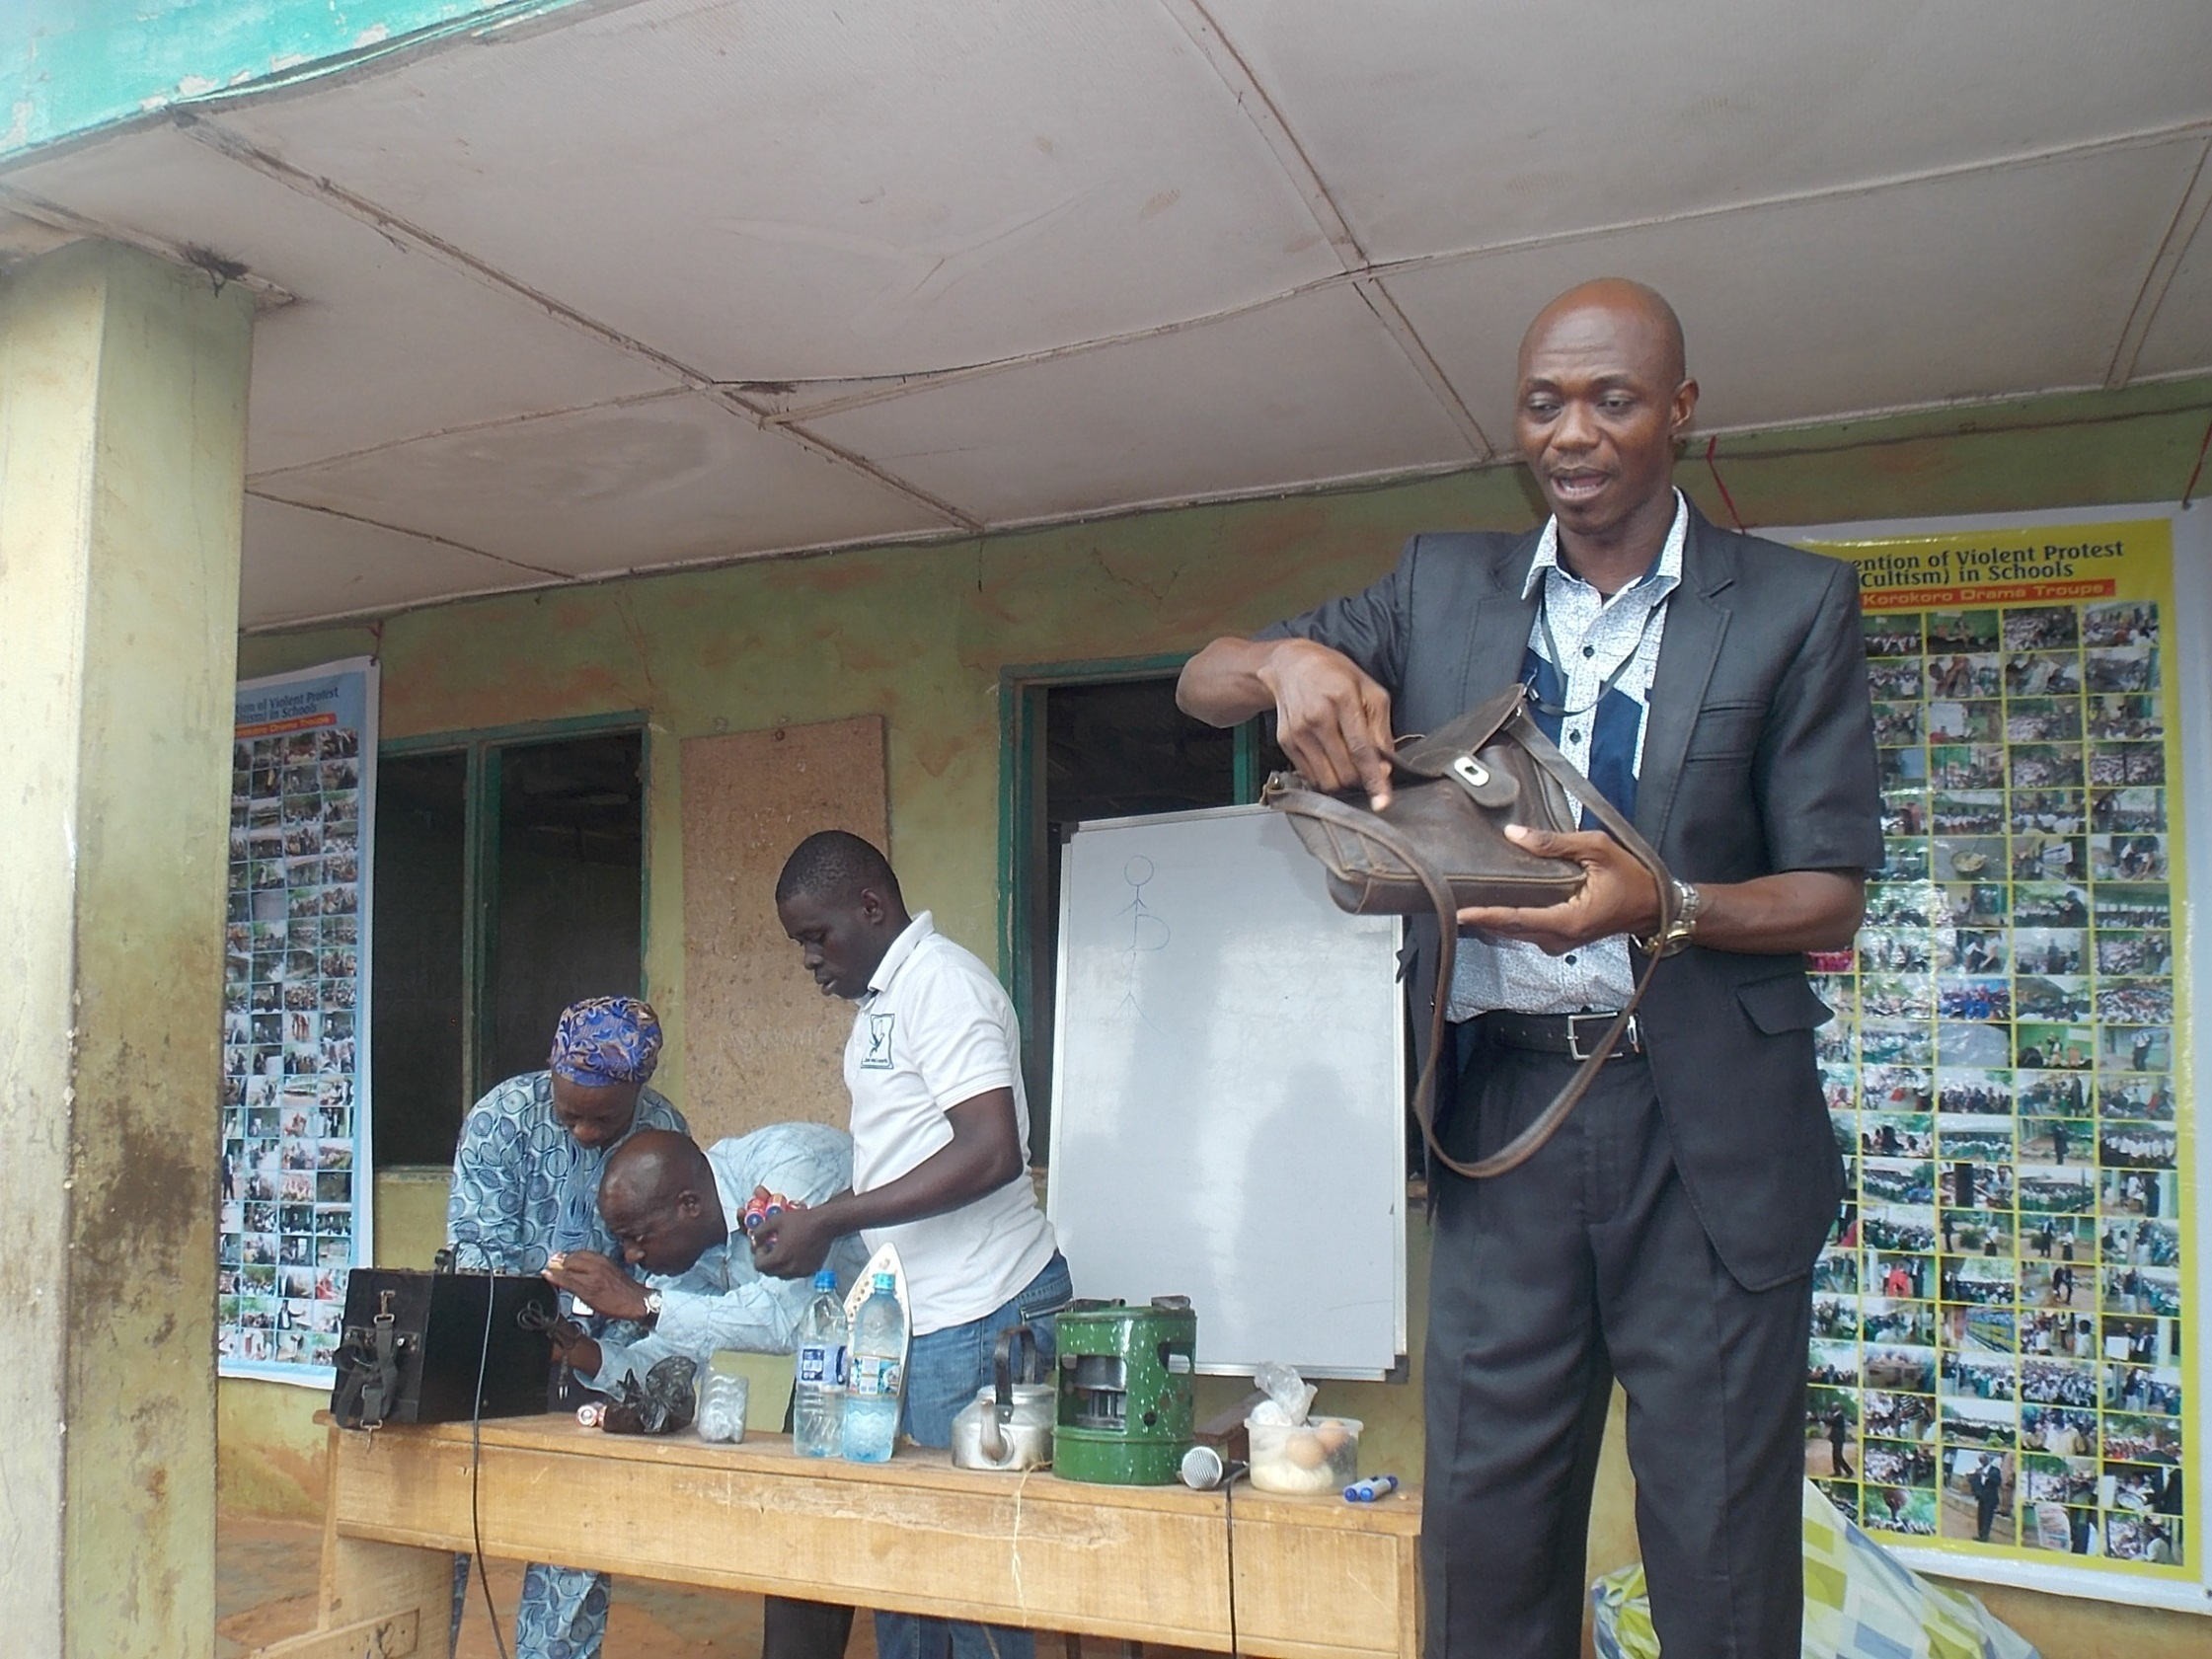

Slide 20
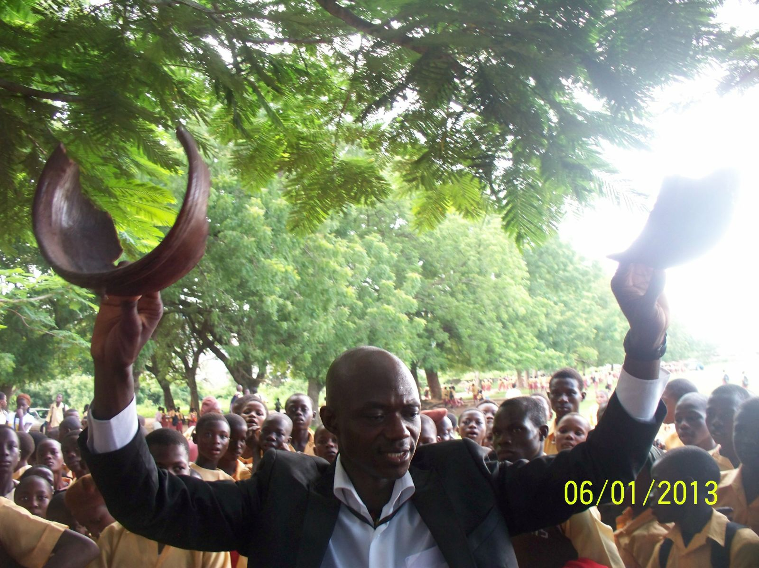

Slide 21
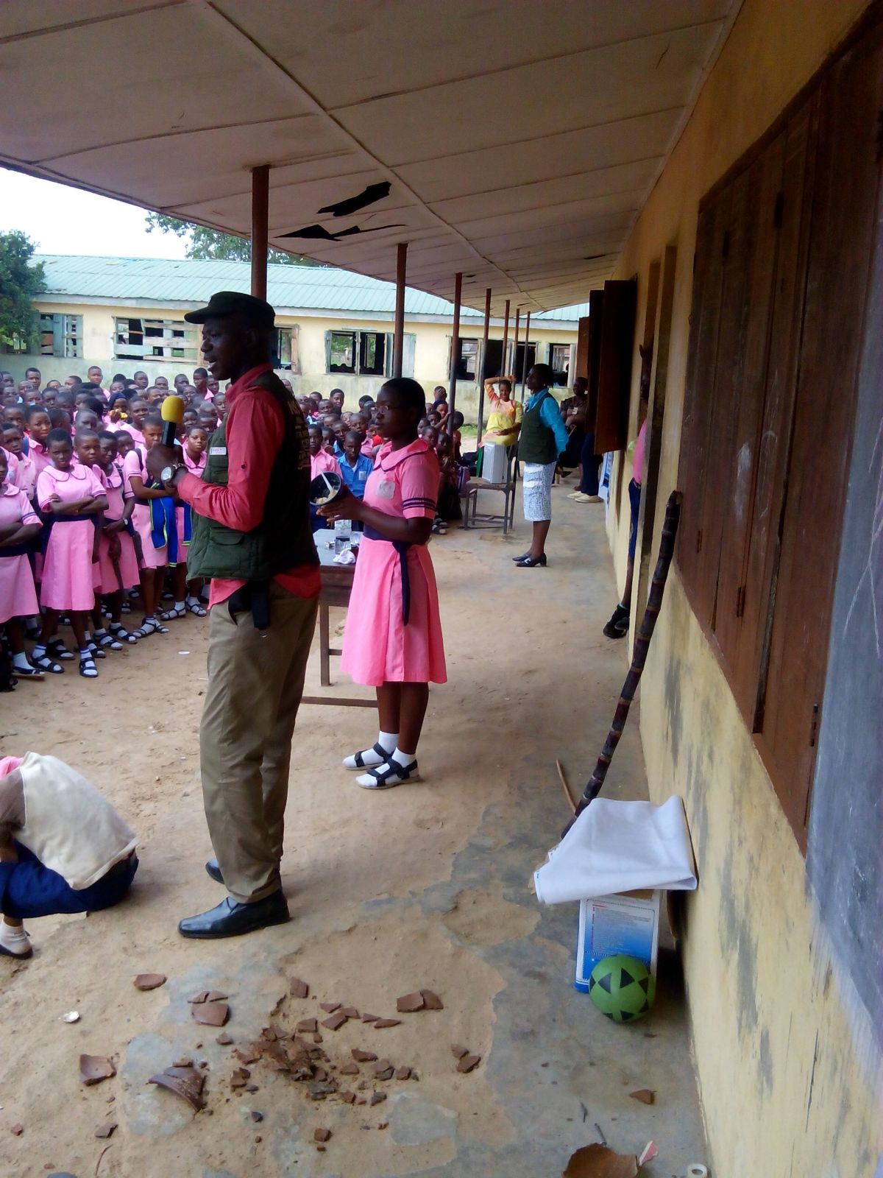
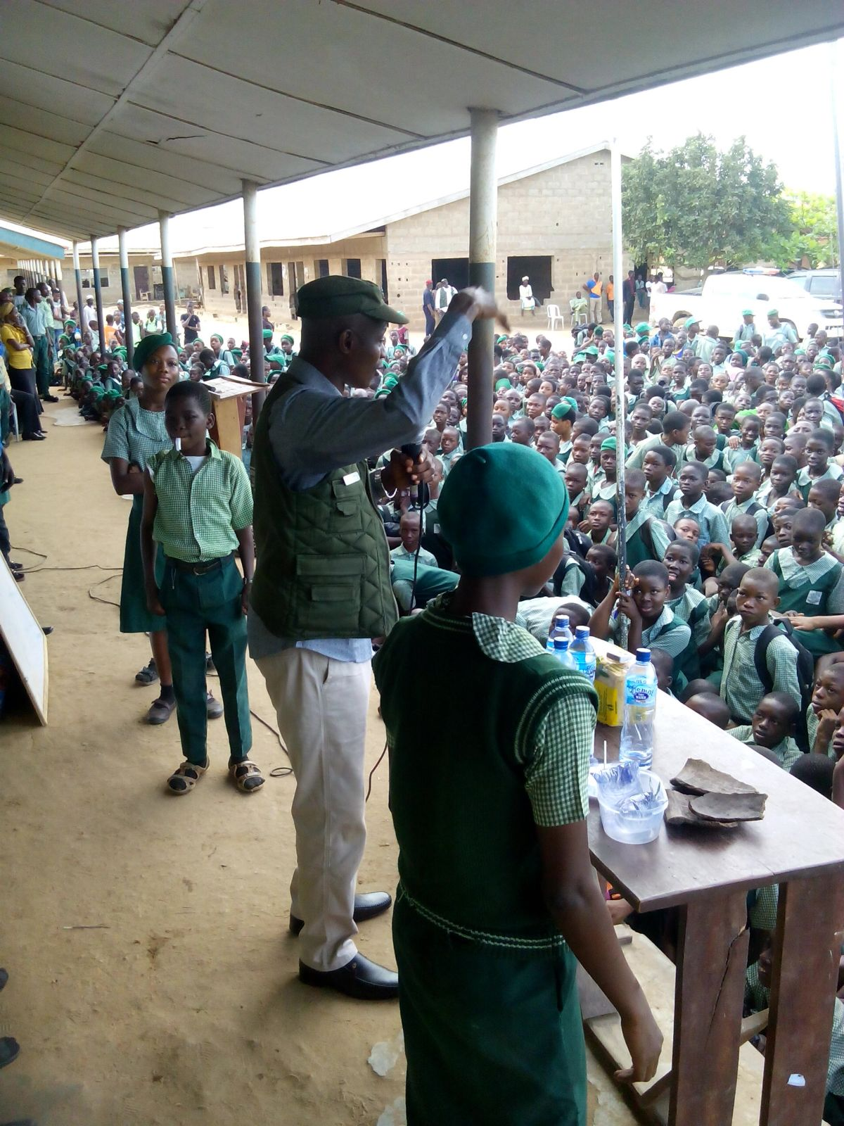

Slide 22
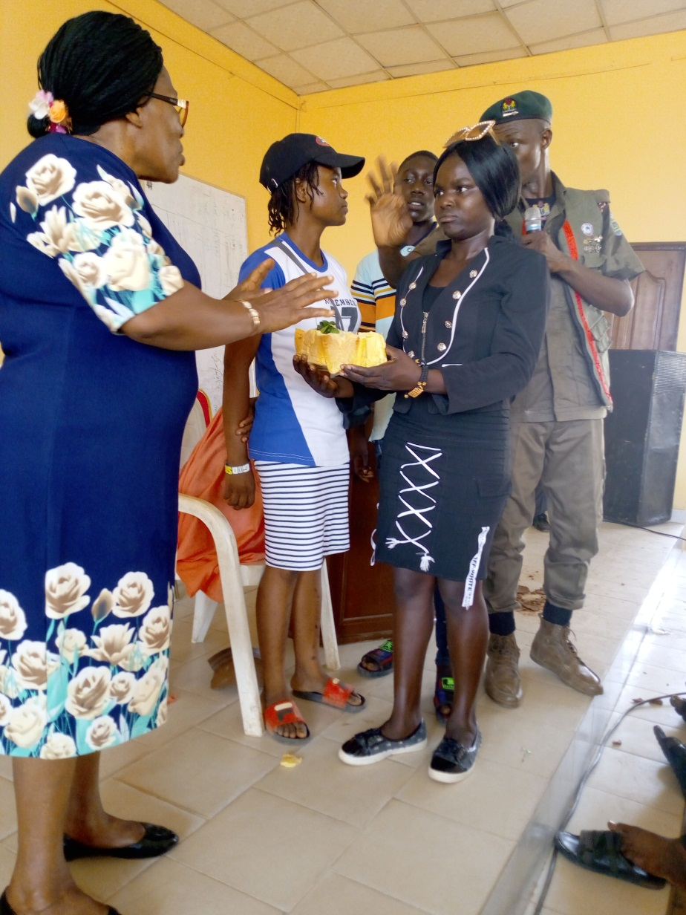
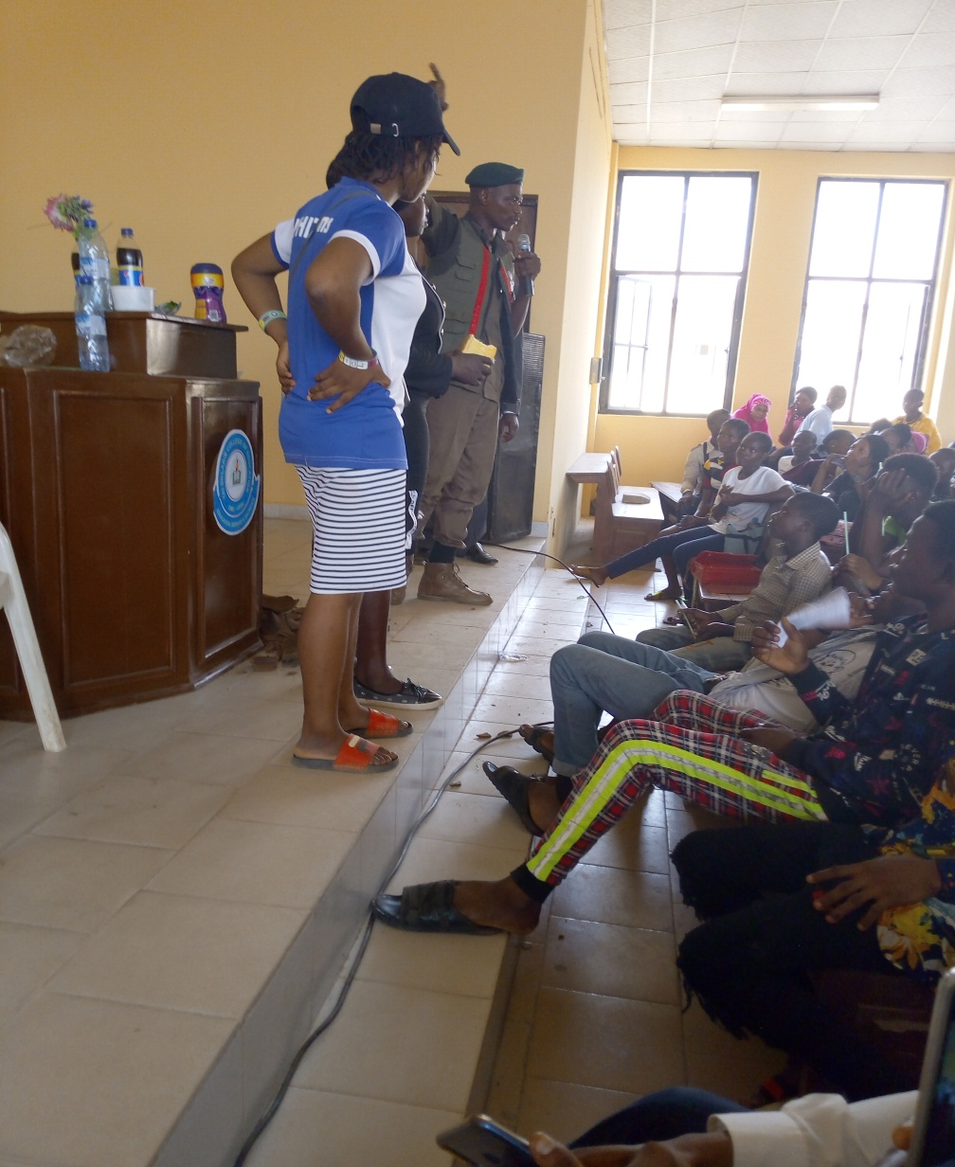

Slide 24
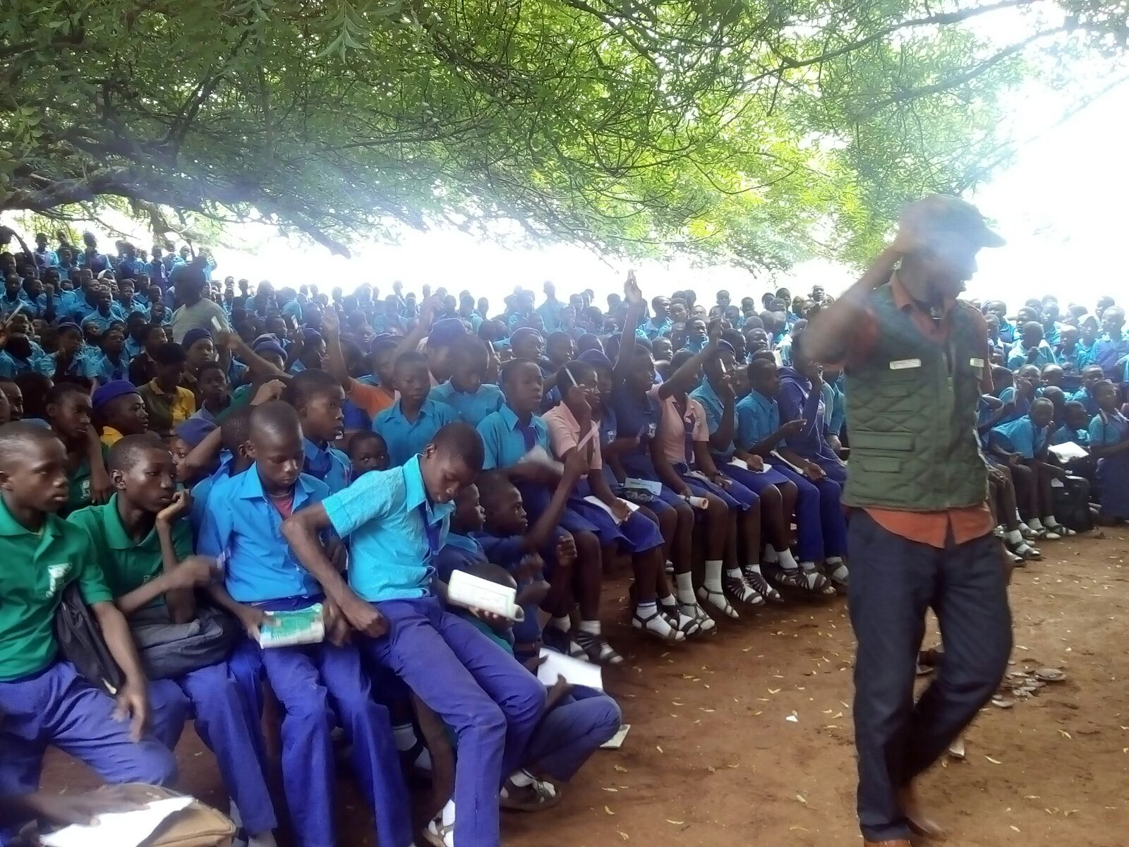

Slide 25
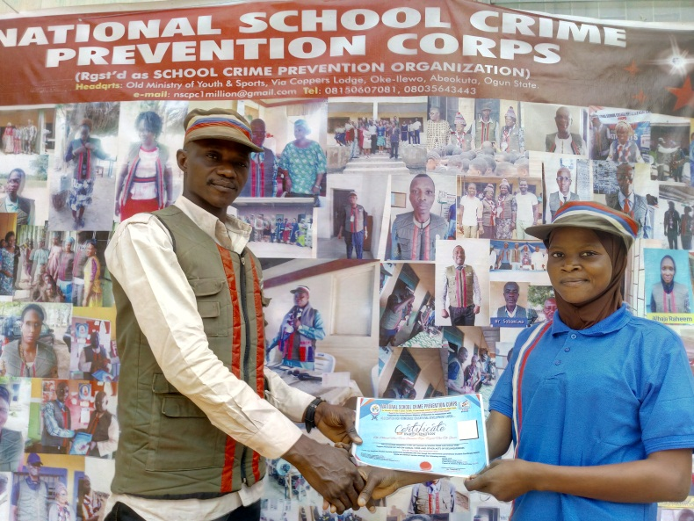
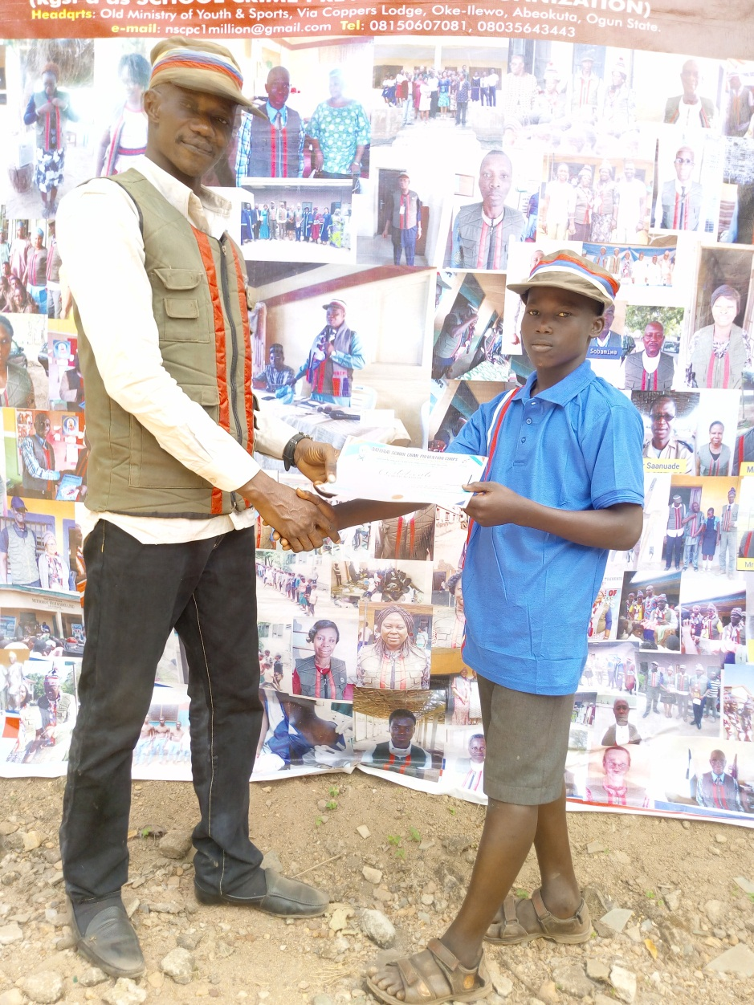
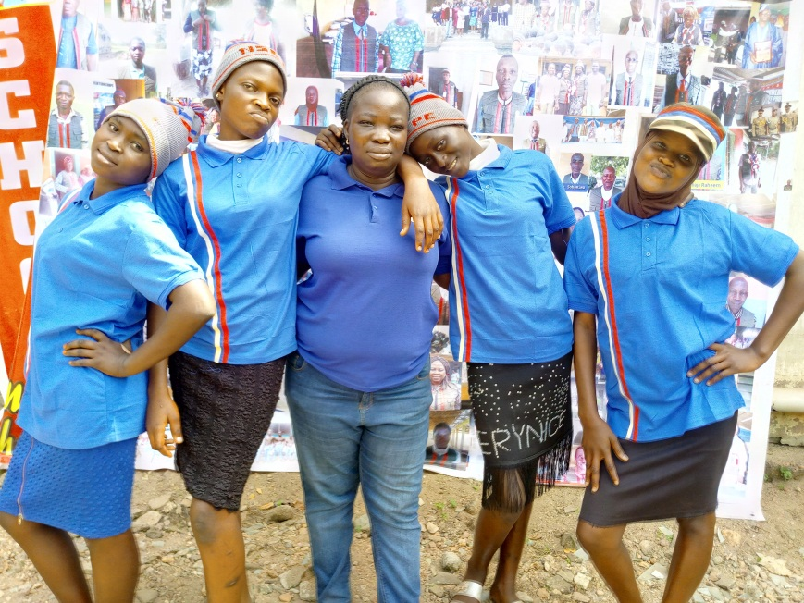
THE PEACE AMBASSADORS

Slide 26
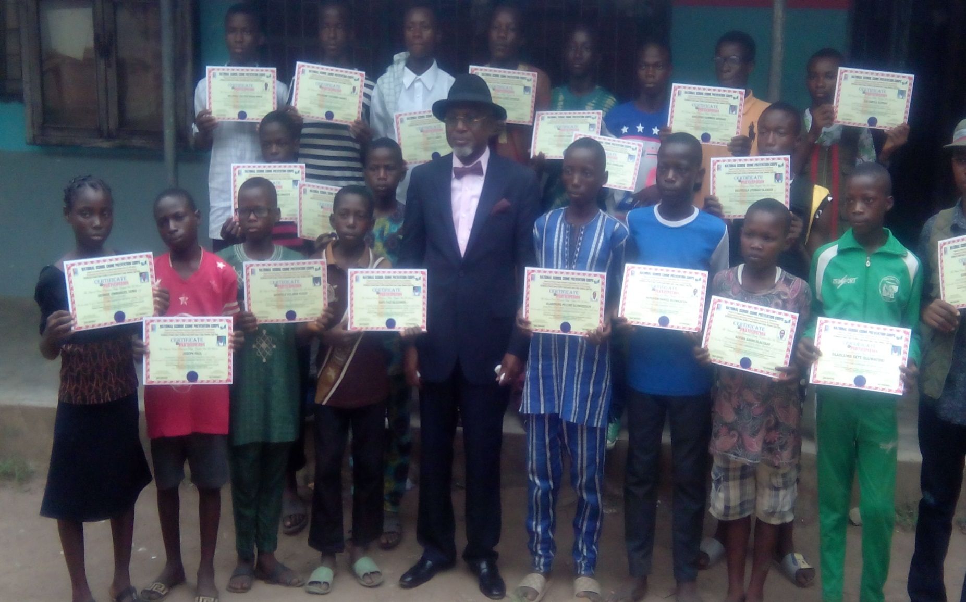
STUEDENTS GIVEN CERTIFICATE AFTER
TRAINING ON SCHOOL CRIME PREVENTION

Slide 27
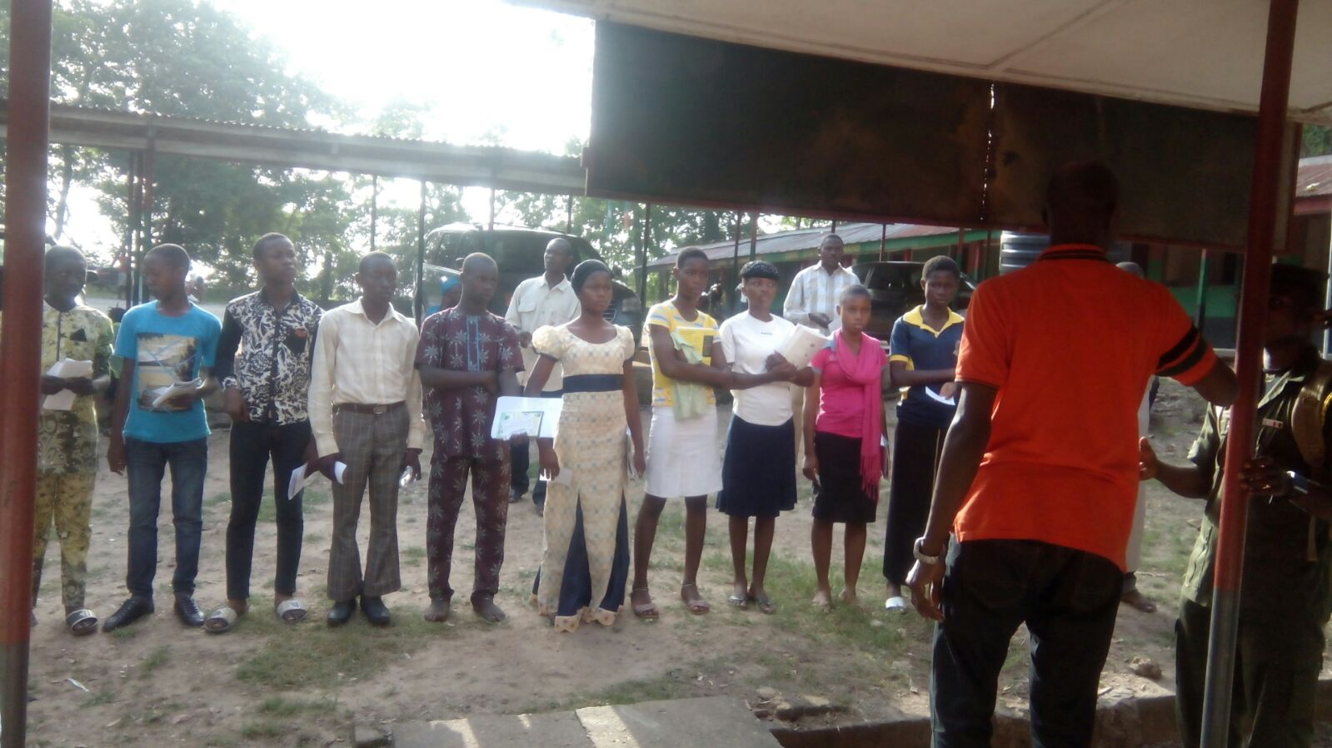
LEADERSHIP CLASS FOR PEACE AMBASSADOR

Slide 28
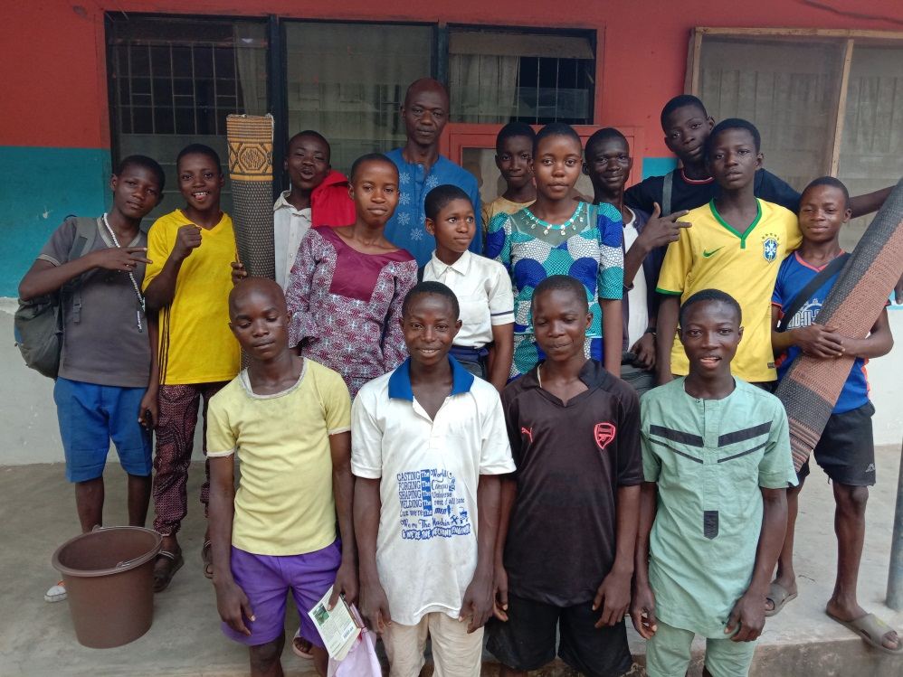
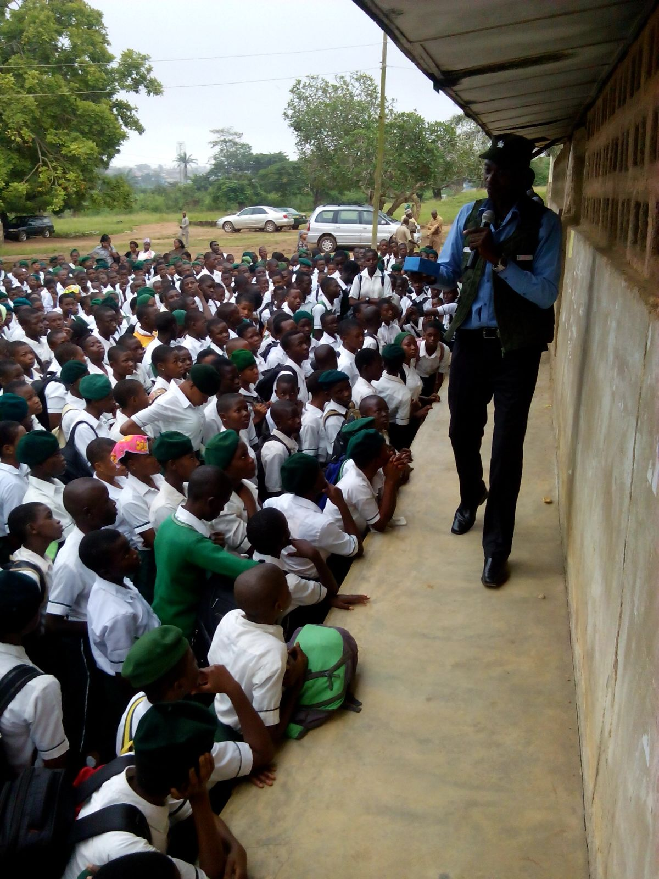
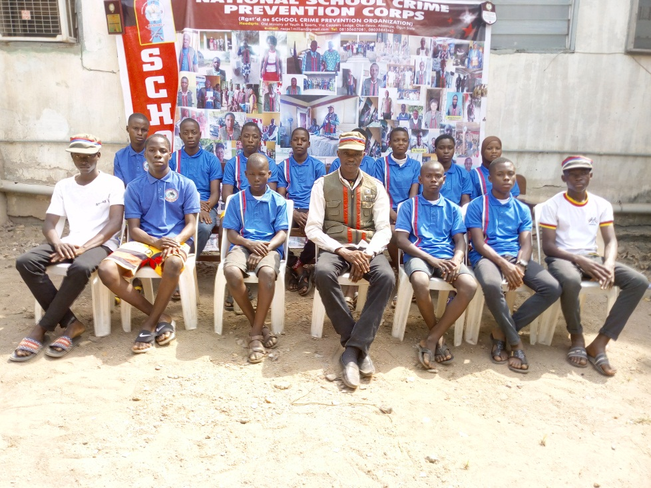

Slide 29
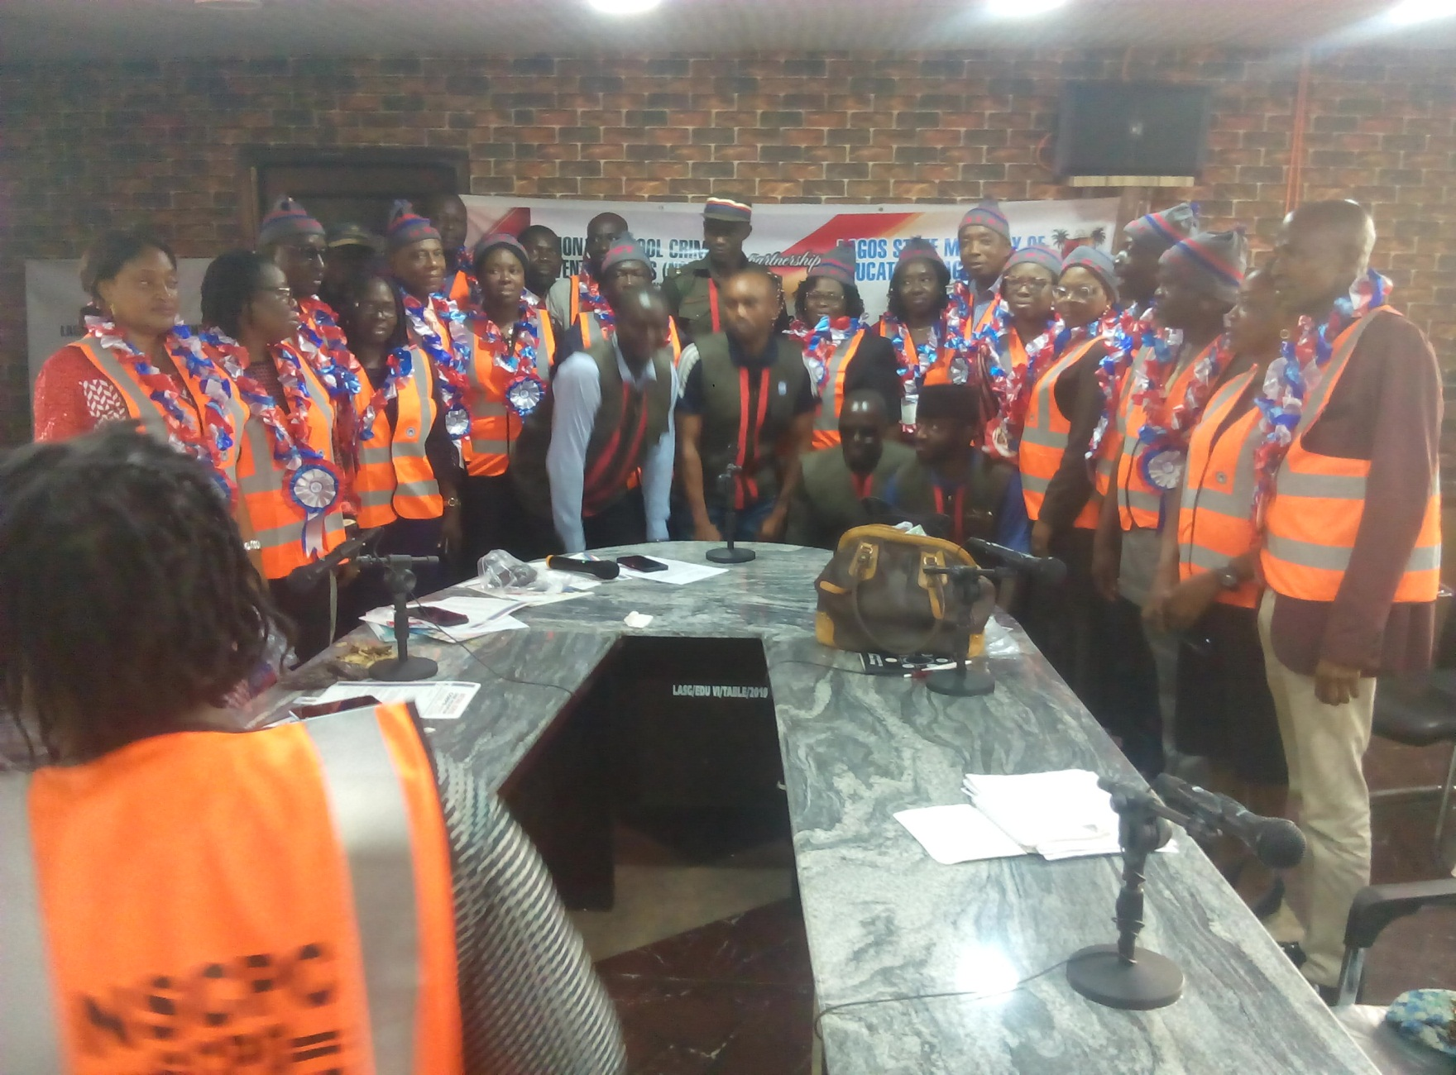
TRAINING OF DIRECTORS IN MINISTRY OF EDUCATION ON ; THEIR ROLE IN CRIME PREVENTION

Slide 30
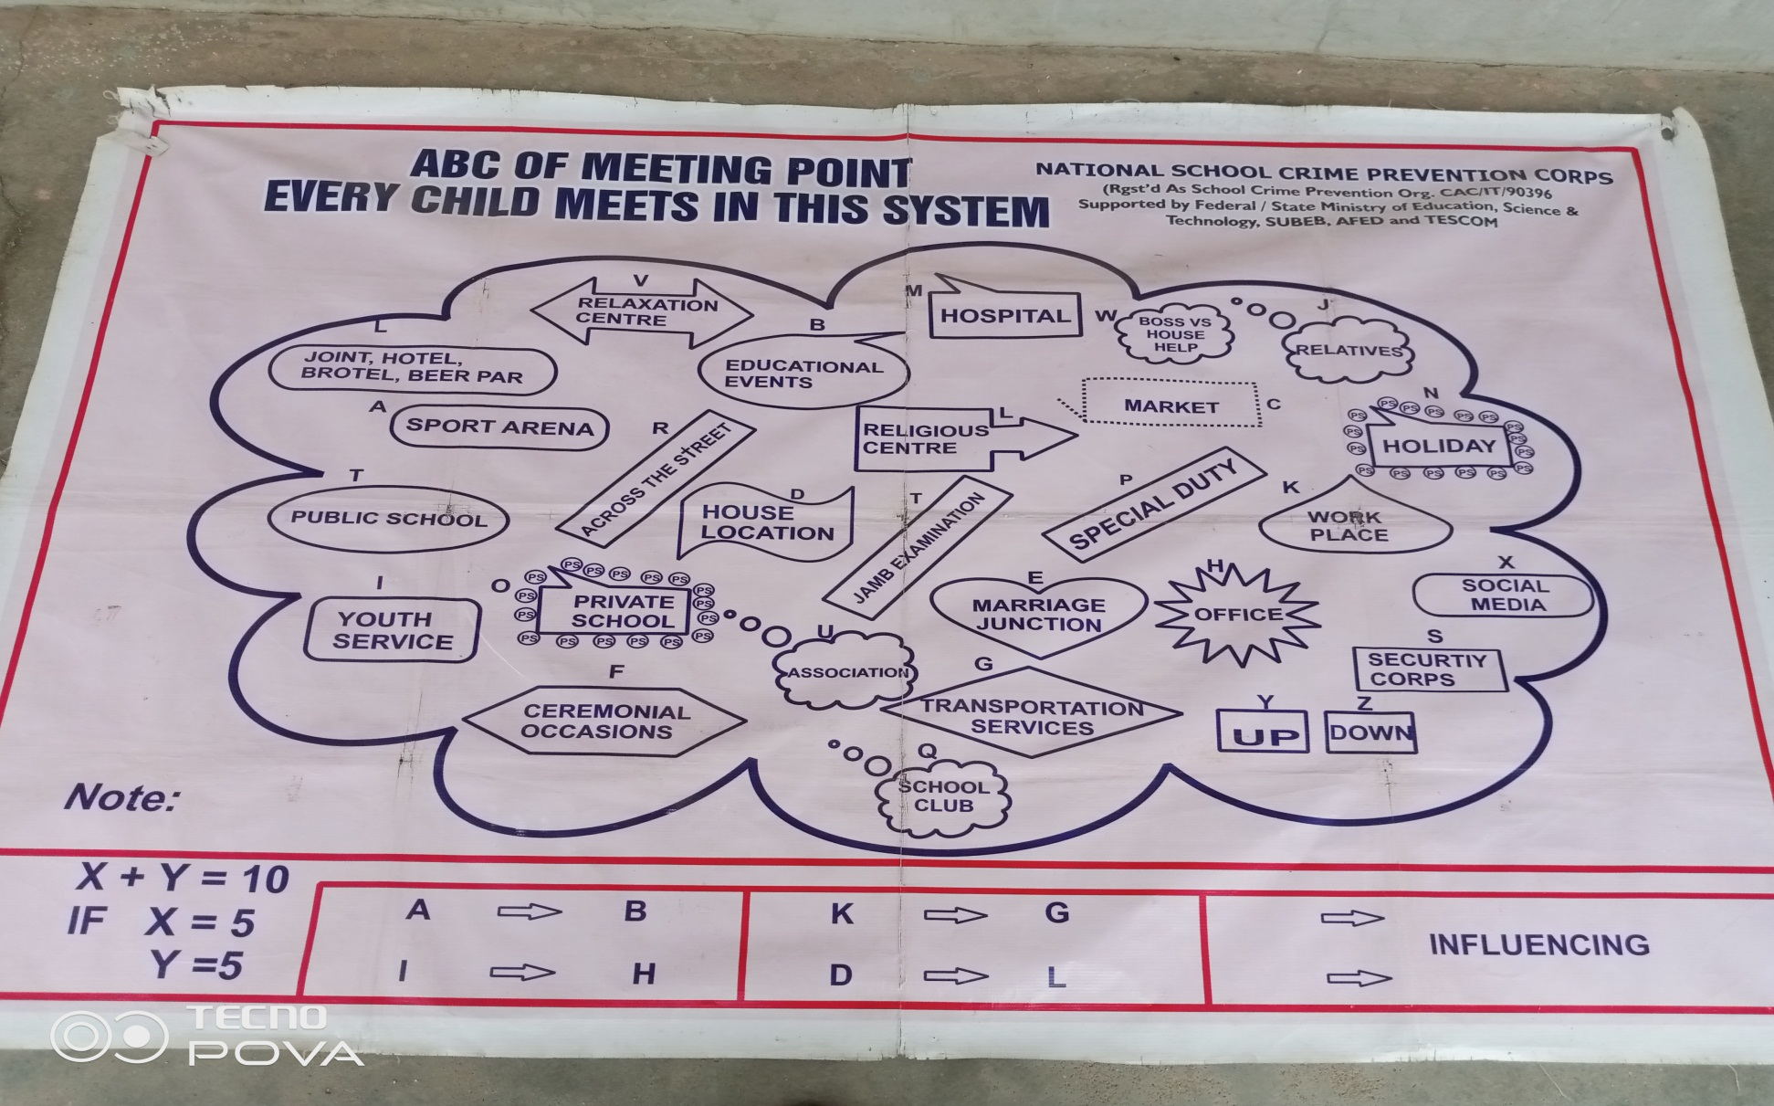
There is always a meeting point

Slide 31
GOVERNMENT BOARD,
FAMILIES,
Primary SCHOOL STUDENTS, secondary SCHOOLS STUDENTS ,
STUDENTS OF tertiary institutions of learning.
CRY FOR HELP !!!

Slide 32
Statistics of Schools Visited

Slide 33
A CRY FOR HELP
AFTER VISUAL METAPHOR DISPLAY
PRESSING QUESTIONS ASKED BY SECONDARY SCHOOL

Slide 34
SCHOOL A
IMPORTANT QUESTIONS
If someone is a cultist, can that person report to you?
I am a girl and one of my neighbor said I should join prostitution.pls sir what can I do?
When someone is a cultist and he can’t leave them because they will kill him. What can he do?
If you leave among them and the person has no parent. How can the person cope in such situation?
How can I desist from a cult that I have already known their secret?
If they are threatening someone to join robbery. What can the person do to be free?
I have been threatening for long to join alora. What should I do?
How can I stay away from people that are involved in cultism?
I am a girl and one of my neighbor said I should join prostitution.pls sir what can I do?
How can I be saved from guys that are disturbing me and how can my brother be save not to join bad gang?
If a person is into cultism, what help can you do to the person?
My friend advised me to join prostitution and cultism and I said know but the person keep on disturbing me. What can I do?

Slide 35
SCHOOL B
IMPORTANT QUESTIONS
If a teacher is the head of a cult and the teacher is caught, what is the consequence
How can we go away from friends who are cultists?
How can we desist from cultism without facing any problem?
If an uncle is touching one’s private part, what can the person do
What are the consequences of joining cultism?
Who can we prevent ourselves from lesbianism?
How can we desist from cultism without facing any problem?

Slide 36
SCHOOL C
IMPORTANT QUESTIONS
What if a parent is a cultist and the parent also want to initiate a child, how will he refuse?
I have joined a cult, how can I come out? Help me out.
I am having a boyfriend that is a cultist, please how can I stop him from that?
How can I speak with you, I want to tell you something about my life?
Is kegite also a cult?
Some teachers are also in cultism and they are initiating students, what can we do sir?
If someone is arrested by cultists and they tell the person to join. What can someone do?
How can someone leave cultism if he is no longer interested in it?
Can anybody join a cult group which a teacher in the school is their leader

Slide 37
SCHOOL D
IMPORTANT QUESTIONS
How can someone get out of cultism?
Can God forgive the people involved in cultism?
If the cultists are troubling me, what can I do to avoid them?
How can we stay away from cultist when they are advising us to join their club?
What are the disadvantages of cultism?
How many years imprisonment can a cultist member undergo?
When a
How can a teenager avoid being a cultist or prostitution when his/her closest friend is one?
When a teacher is doing bad thing what should we do as a student?

Slide 38
SCHOOL E
IMPORTANT QUESTIONS
What if the person has already taken an oat and they said if he/she tries to run away or tell anyone, they will kill him. What can the person do?
I love raping but I wish to stop, how can I stop it?
How can we avoid people that are cultist and they are befriending us?
What are the steps to take to withdraw as a cult member?
Why is it that some policemen and arm forces are cultists’ god father?
I am a dating a guy who is a cult member, what should I do?
What do we do when we notice a cult member in the class?
What can be done to a cultist found with a gun and he has a license to the gun and he is using it to violate the law?
What are the signs and slogans to identify a cultist?
If someone close to you is involved in cultism. What can you do to make the person out?
What if a cultist member threatens and told me not to tell police or anyone and if I do, he said he will kill me. What should I do?

Slide 39
SCHOOL F
QUESTIONS
Is it good for the teacher to be touching the student?
How can a cult member desist from it and turn a new life?
Is it good to tell the police or principal about the plan of the cultist?
How do we move away from violent peer group?
How can we recognize cultist in our environment or society?
How can a drunker or smoker get out of it?

Slide 40
SCHOOL G
QUESTIONS
If someone wants to force me to join cultism and he said if I did not join that he will kill me, please what can I do?
Why are cultists killing themselves?
How can we communicate with you people for more advice?
Why do we have cultist children in the school?
How can we communicate with you people for more advice?
Is it good to be drinking palm wine at the back of the school?

Slide 41
SCHOOL H
QUESTIONS
If a person is in a cultist, they said the person can’t come of it. Is it true?
What can make a student to join cultism?
How can we prevent Prostitution and cultism in our society?

Slide 42
SCHOOL I
QUESTIONS
How can a cult member quit from the group and they won’t be killed?
When you are pressurized by cult group to join them, what do you do?
How can a cult member quit from the group and they won’t be killed?
What can we do so that we won’t be influenced by our peers during our school activities?
How can we change the mind of a person that has joined cultism?
What can I do if I find myself in a difficult situation?
What can we do so that we won’t be influenced by our peers during our school activities?

Slide 43
SCHOOL J
QUESTIONS
If a person has already joined cult, how will he/she be out?
There is one boy threatening me to join the cult group, please what can I do?
If a person is a cultist, how will that person get out?
Is it possible for a cultism to be a governor/president in life?
What can we do when those that want us to be a cult are frustrating us?
When someone is a cultist, is it possible for the person to leave or not?
How can someone come out of cultism without being disturbed by the cult member?
How can I avoid my friend that is a member of cultism?
How can we refuse if cultists are forcing us to join them?
How do you know a person that is a cultist?

Slide 44
SCHOOL K
QUESTIONS
How can we recognize a cultist in our society or in school?
How can we prevent ourselves from bad gangs?
How can someone be great in life without going through a hard way?

Slide 45
PREVENTING CRIME IN SCHOOLS
THE OUTCOME IN GLANCE

Slide 46
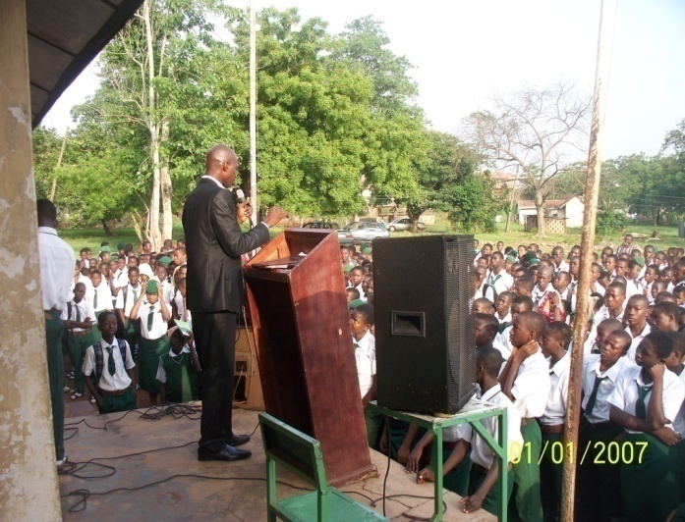
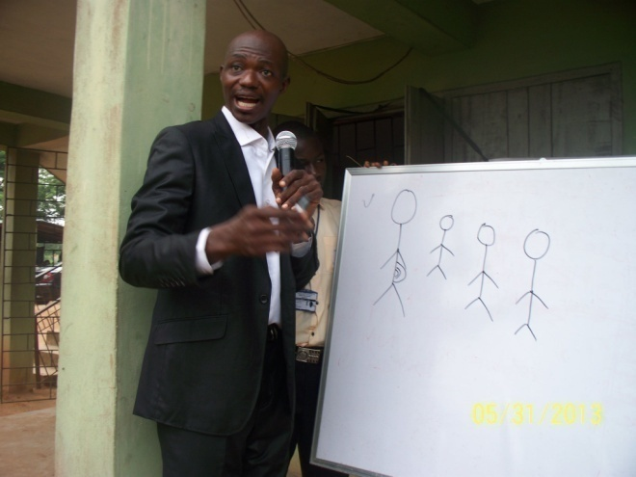
REDUCTION OF SOCIAL VICES / CULTISM IN SECONDARY/PRIMARY SCHOOL;
The reduction subsequently reduces robbery rate.
REDUCTION OF TRUANCY IN SCHOOLS;
This also increases the participation of students to learn and increase more for National Productivity.
REDUCTION OF SPATE OF RITUAL KILLING;
Any student in cultism is a soft ground for the mental breeding as ritual killers. This also will be subsequently reduced .
REDUCTION OF ROBBERY ACT ACROSS THE STATE
The bedrock of robbery is cultism, and this will be reduced geometrically.
REDUCTION OF YAHOO + SYDROME.
Cultism is an easy diversion to a state of hopeless, desperation which result to yahoo+ , thus this will be achieve via application of VMD.
REDUCTION OF THE SPATE OF KIDNAPPING IN THE COMMUNITY
Exposition to cultism is a fertile ground for kidnapping business.
REDUCTION OF THE RATE OF DRUG ADDICTION
Fact amounts for many in cultism are drug addict and vice versa

Slide 47
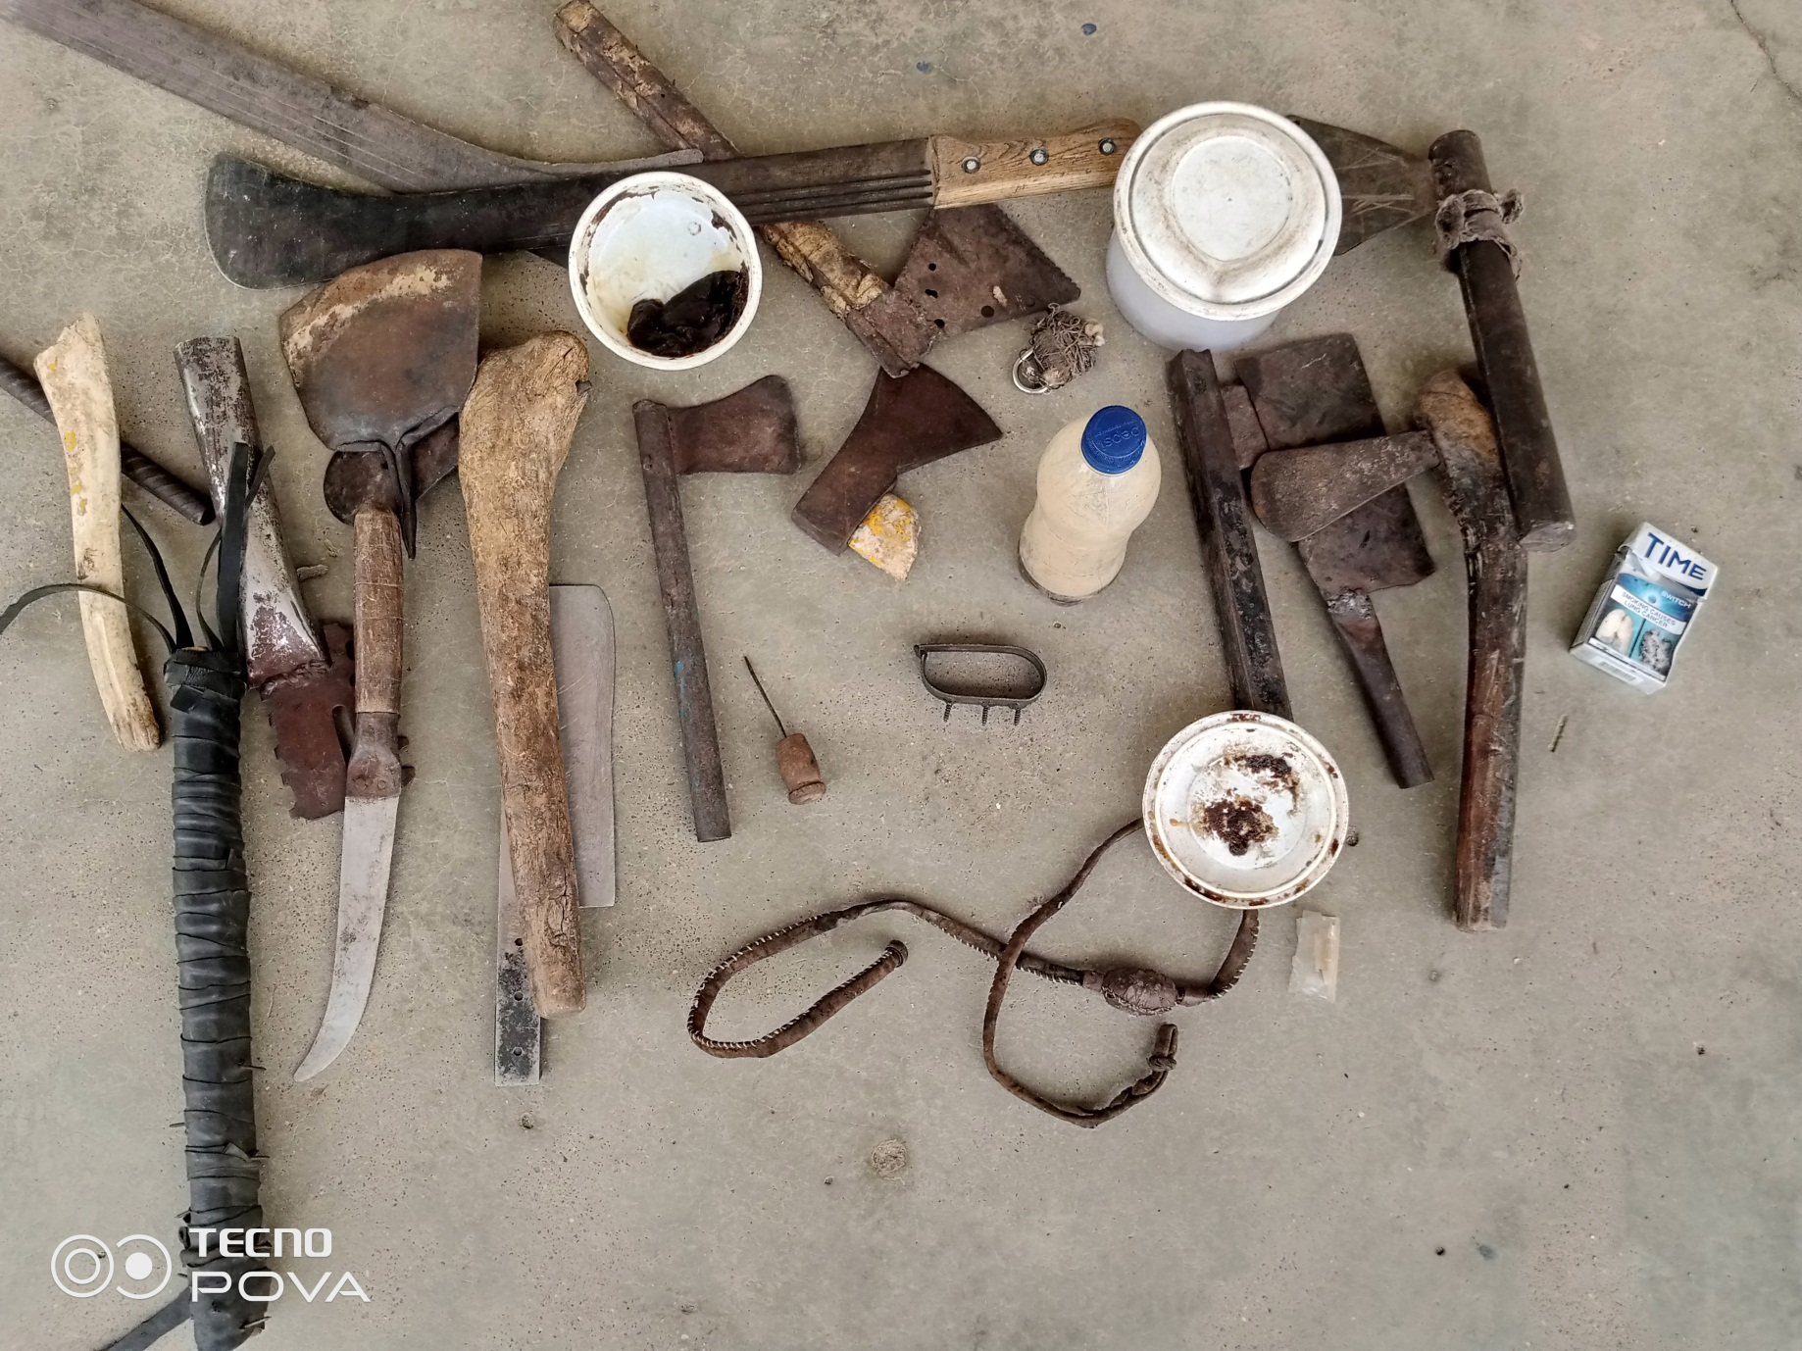
LIGHT AMUNITIONS RETRIEVED FROM STUDENTS

Slide 48
CORRESPONDENCIES ACROSS
NSCPC CORRESPONDENCE TO THE HON MINISTER OF EDUCATION -‘REQUEST TO COLLABORATE TO REDUCE THE TREND OF CULTISM IN SECONDARY SCHOOLS ACROSS THE COUNTRY’ - 17TH JULY 2018.
HON. MINISTER OF EDUCATION REPLY TO NSCPC -“I Am Directed To Refer To Your Letter Dated 17th July 2018 On The Above Subject And To Commend Your Organization For Such A Lofty Initiative….you are advised to continue the program with other States”- 6th Aug’2018 , SAF 27/GEN/161/1
NSCPC CORRESPONDENCE TO VICE CHANCELOR REDEEMER UNVERSITY-‘CRIME AND THE PREVENTION OF SOCIAL VICES IN SCHOOL,APPLICATION OF VMD’ – 13TH MAY, 2019
VICE CHANCELOR REDEEMER UNVERSITY REPLY TO NSCPC - “The Management sincerely commends your laudable idea on national school crime prevention. With Organization like yours and the level of your devotion, we have the conviction that there is hope for a ‘CRIME-FREE’ Campus in Nigeria Higher Institution of learning”. – 11TH JULY, 2019, /RUN/REG/GEN. CORR. /222/VOL.8/168.
NSCPC CORRESPONDENCE TO THE HON MINISTER OF EDUCATION ; -INTEGRATING GOVERNMENT APPARATUS TO CURB CULTISM (VIOLENT PROTEST) AND SOCIAL VICES IN SCHOOLS ACROSS THE NATION - 14^{TH,} AUGUST, 2019.
HON. MINISTER OF EDUCATION REPLY TO NSCPC -“…Sequel to the above, you are advised to continue your program in all the States of the Federation for the reduction of crime in Nigeria -”7TH OCTO, 2019, FME/RC/NSCPC/01/1
NSCPC CORRESPONDENCE TO THE EXECUTIVE CHAIRMAN SUBEB, OGUN- STATE; REQUEST FOR APPROVAL TO SENSITIZE PRIMARY SCHOOLS ON SOCIAL VICES AND OTHER ACTS OF DELINQUENCIES. Etc etc.

Slide 49
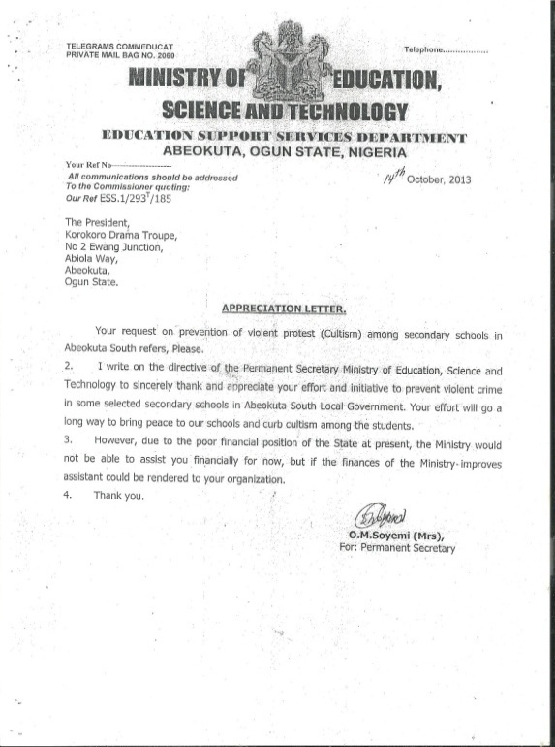
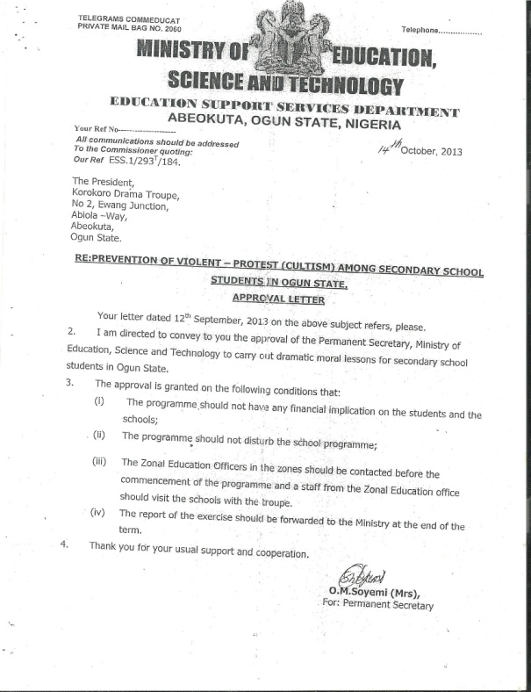
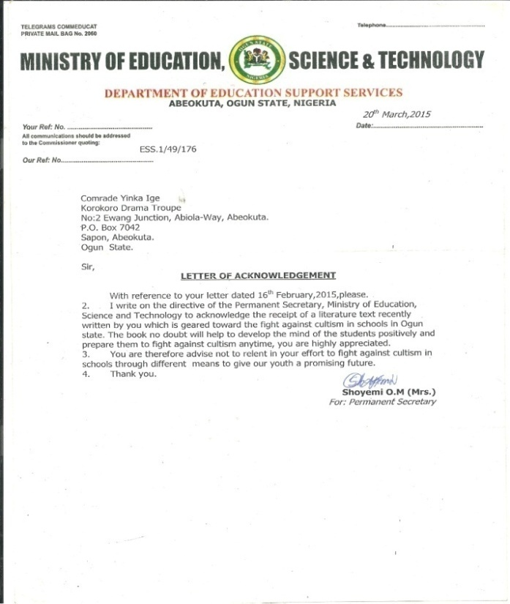
GOVERNMENT AUTHOURITY LETTERS

Slide 50
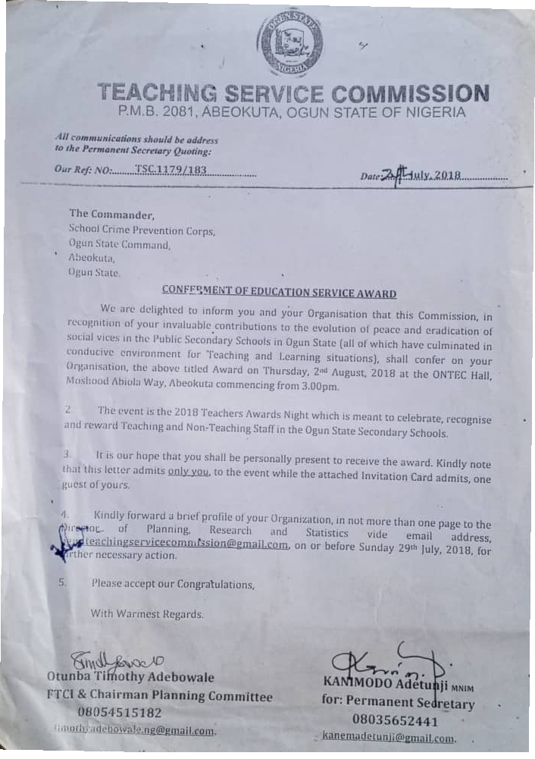
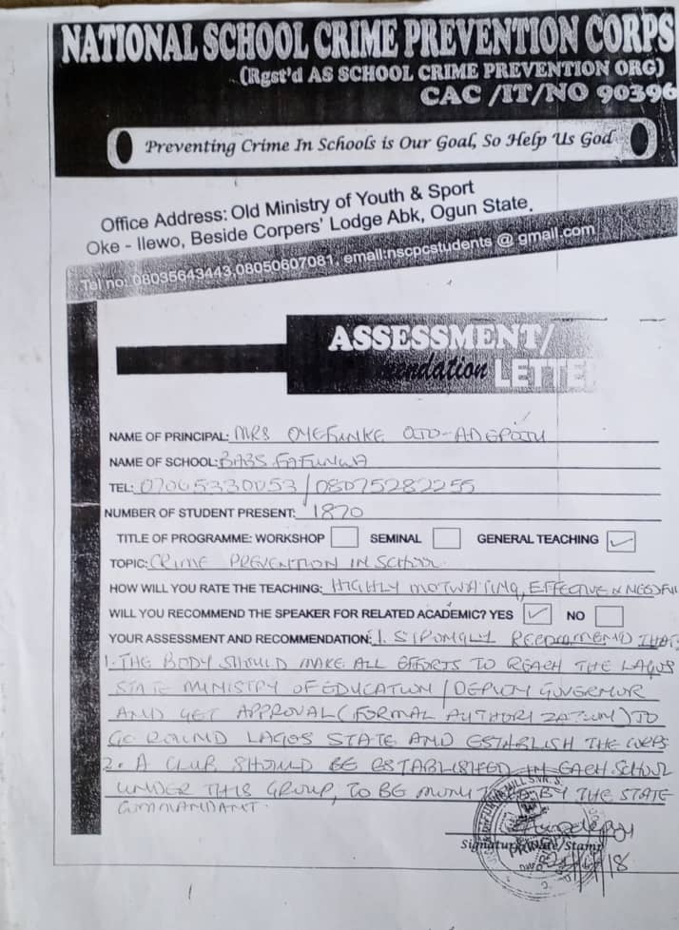

Slide 51
CONCLUSSION.
As Educational Experts, we all know that the threat against the foundational pillars of educational system all over the World is getting larger every day and School Manager and Stakeholders in every estate of knowledge must promptly rise to address the issue to save our children and our heritage before it is swept away by the ignorant, and more importantly the security network of our schools must not be weaken as that serves as the industry of better change for every Nations across the World.
Thank you very much and, GOD ALMIGHTY bless.

Slide 52


